Slide 1
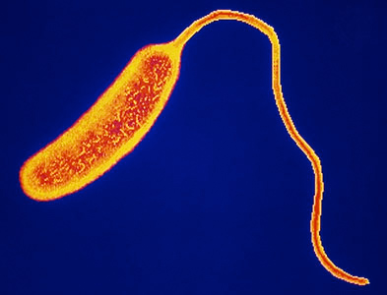
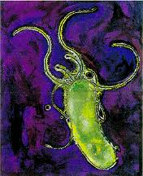
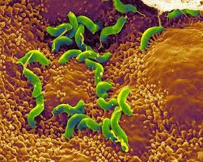
Infectious Diseases
Lesson 2.4

Slide 2
Lesson Objectives:
After finishing today’s lesson you will be able to:
define Koch’s postulates.
apply Koch’s postulates to investigations of infectious disease.
describe one limitation of each postulates.

Slide 3
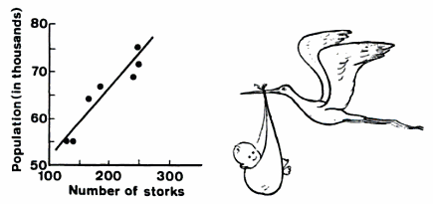
Do Now
What is the difference between correlation and causation?
How Ice Cream Kills!

Slide 4
Do Now
What is the difference between correlation and causation?
Correlation implies some relationship between 2 variables but it does not prove causation.
Causation is proven when one variable or action directly leads to the other.
How could you prove causation?
Isolate an infectious agent that is found at both the original source of the infection and in the infected person. Need to show that the infectious agent that was isolated can cause the same disease.
How would you tell the difference between a microbe that causes a disease and one that is only associated with a disease?

Slide 5
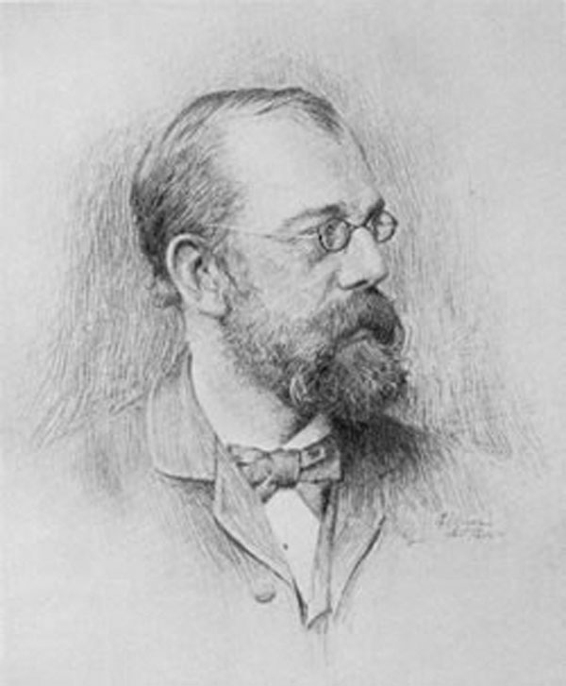
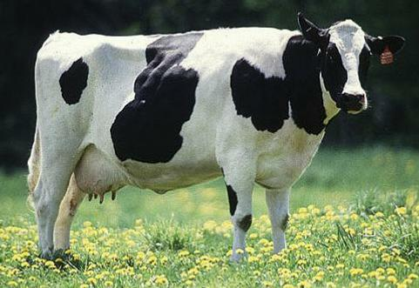
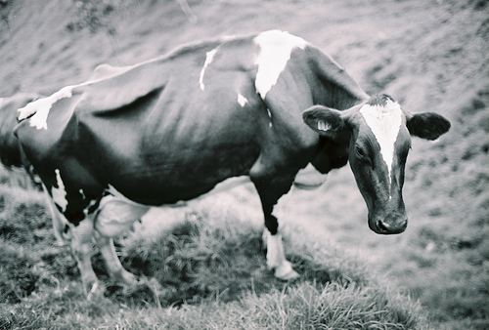
Robert Koch – connecting the dots to disease
healthy animal
sick animal
healthy animal
✕
Pure culture of
Bacillus anthracis
Bacillus anthracis
Bacillus anthracis
sick animal

Slide 6
Identifying the infectious agent – Koch’s postulates
Association – The infectious agent must always be present in every case – but not in healthy animals.
Isolation – It must be isolated from the sick animal into pure culture.
Causation – The pure microbe must cause the disease in a healthy animal.
Re-isolation - When the microbe is re-isolated from the sick animal it must be the same as the original.

Slide 7
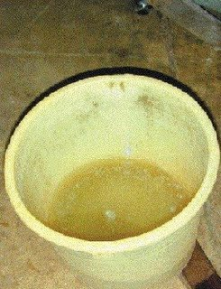
Applying Koch’s postulates to cholera in people: Step 1
Association – It must always be present in every case – but not in healthy animals.*
Isolation – It must be isolated from the sick animal into into pure culture.
Causation – The pure microbe must cause the disease in a healthy animal.
Re-isolation – When the microbe is re-isolated from the sick animal it must be the same as the original.
*Can you think of exceptions from this rule?
Typhoid Mary (healthy carrier), TB (90% get the latent form)
Sack et al., 2004
All people with cholera have diarrhea (rice water stool) that contains high concentrations of bacteria

Slide 8
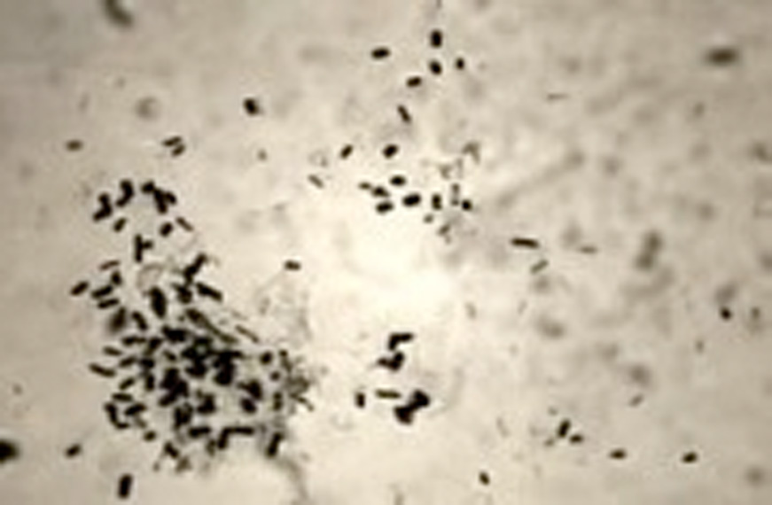
Applying Koch’s postulates to cholera in people: Step 2
Association – It must always be present in every case – but not in healthy animals.
Isolation – It must be isolated from the sick animal into pure culture.*
Causation – The pure microbe must cause the disease in a healthy animal.
Re-isolation – When the microbe is re-isolated from the sick animal it must be the same as the original.
*What if that is not possible?
Some diseases are caused by a small amount of microbes like meningitis (hard to find), some bacteria reside is hard to access areas of the body (lyme disease). Most bacteria (99.9%) will not grow in cultures. Most bacterial pathogens will but some still do not (syphyllis, leprosy).
Isolation is easy in the diarrhea,
100,000,000 bacteria/mL
Vibrio cholerae

Slide 9
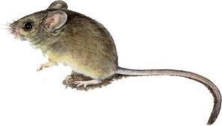
Applying Koch’s postulates to cholera in people: Step 3
Association – It must always be present in every case – but not in healthy animals.
Isolation – It must be isolated from the sick animal into into pure culture.
Causation – The pure microbe must cause the disease* in a healthy animal.
Re-isolation – When the microbe is re-isolated from the sick animal it must be the same as the original.
*Will that always be the case? What if a disease develops over many years?
The microbe may not cause disease in the animal (HIV, cold virus). Some people are in good health to fight the disease, or have had immunizations or previous exposure against the disease, or genetic immunity. Some disease lie dormant for years or the person can be a healthy carrier.
Giving potentially infectious microbes to humans is not ethical, so animal models are the next best thing ☹
Vibrio cholerae

Slide 10
Applying Koch’s postulates to cholera in people: Step 4
Association – It must always be present in every case – but not in healthy animals.
Isolation – It must be isolated from the sick animal into into pure culture.
Causation – The pure microbe must cause the disease in a healthy animal.
Re-isolation – When the microbe is re-isolated from the sick animal it must
be the same* as the original.
Will we expect it to be exactly the same?
Microbes evolve constantly
Sack et al., 2004
Vibrio cholerae

Slide 11
Wrap Up:
What if Koch’s postulates can’t be fulfilled?
Association – It must always be present in every case – but not in healthy animals*.
Isolation – It must be isolated from the sick animal into pure culture**.
Causation – The pure microbe must cause the disease* in a healthy animal.
Re-isolation – When the microbe is re-isolated from the sick animal it must be the same*** as the original.
* Typhoid Mary.
** Leprosy or the plague.
*** Microbes mutate constantly.

Slide 12
Homework
Using your homework sheet, design an experiment to test the hypothesis that ‘excessive stomach acid’ causes ulcers.

